Slide 1
ADHD Complexity Explored: The Interplay of Emotional Dysregulation and Rejection Sensitivity Dysphoria

Slide 2
MEET OUR TEAM
Gary Johnson, Ph.D., LMFT
Kelsey Maleski, PsyD
Kotatee Tamba, PsyD, LICSW
Benjamin Kortuem,
PsyD, LP

Slide 3
History of ADHD Diagnostic Criteria

Slide 4
The Unacknowledged Role of Emotion in ADHD
Current diagnostic criteria for ADHD include no mention of problems with with emotions.
Yet Emotions: Positive and Negative Plays a huge role in Attention and Focus.

Slide 5
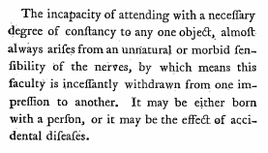
1798-Sir Alexander Crichton

Slide 6
1902-Sir George Frederic Still
British pediatrician Sir George Frederic Still described “an abnormal defect of moral control in children.” He found that some affected children could not control their behavior and emotions the way a typical child would, but they were still intelligent
Notes:
A DEFECT OF MORAL CONTROL
Later, in 1902, a British paediatrician named Sir George Still gave three lectures to the Royal College of Physicians of London. These lectures were titled “On Some Abnormal Psychical Conditions in Children”. In one, Still discussed psychiatric conditions which he believed to be “an abnormal defect of moral control in children”.
His description of these cases are today considered to be historical descriptions of ADHD. The children were noted to have a “defect of moral control as a morbid manifestation, without general impairment of intellect and without physical disease”.
Interestingly, these cases also displayed “a quite abnormal incapacity for sustained attention”.
The lectures are considered by many to be the first clear historical record of ADHD / ADD.

Slide 7
1908- Postencephalitic Behavior Disorder
Postencephalitic Behavior Disorder :Changes in personality, emotional instability, cognitive deficits, learning difficulties, sleep reversals and poor motor control.

Slide 8
1932-Hyperkinetic disease of infancy
Hyperkinetic disease of infancy (The most characteristic symptom of affected children was a marked motor restlessness)

Slide 9
1968 DSM-II: HYPERKINETIC REACTION OF CHILDHOOD
The symptoms were described as being “characterized by overactivity, restlessness, distractibility, and short attention span”

Slide 10
1980-DSM-III: Attention deficit disorder (With and Without Hyperactivity).
Focus on hyperactivity was shifted toward an emphasis on the attention deficit in affected children.
Deficits in sustained attention and impulse control were more significant features of the disorder than hyperactivity or emotion dysregulation.
These symptoms were the ones showing the best response to stimulant treatment.

Slide 11
1994-DSM IV Attention Deficit Hyperactivity Disorder
Predominantly Inattentive Type, predominantly hyperactivity-impulsive type and combined type
Accredited the diagnosis of ADHD in adulthood by including examples of workplace difficulties in the depiction of symptoms.
In DSM-IV, there was a requirement for at least 6 symptoms from either the inattention or hyperactivity-impulsivity criteria to be present for diagnosis.

Slide 12
2000 DSM IV-TR Attention Deficit Hyperactivity Disorder
DSM-IV TR and the ICD adopted an almost identical criteria for the identification of inattentive, hyperactive, and impulsive symptoms.
The subtypes from the DSM-IV were removed and replaced with one diagnosis of ADHD, with specifiers for the predominant symptom presentation (inattentive, hyperactive-impulsive, or combined).
In DSM-IV TR, the number of symptoms required for diagnosis was reduced to 5, with at least 2 symptoms from each of the inattention and hyperactivity-impulsivity criteria.

Slide 13
2013 DSM-V Part of Neurodevelopmental Disorders
ADHD is now considered a part of a larger category called "Neurodevelopmental Disorders”
DSM-5 includes more information on the onset, duration, and impairment caused by the symptoms, as well as the need for a comprehensive assessment by a healthcare professional.

Slide 14
Why should we Care?
It defines who and what will be studied.
It defines who will be diagnosed with ADHD and who will not.
It defines who will get treatment and how treatment will be provided.
It defines who will get insurance coverage.
It defines wo will get accommodations in school and work.

Slide 15
Rejection Sensitive Dysphoria and Emotional dysregulation

Slide 16
What is Rejection Sensitive Dysphoria?
RSD: is a condition that is characterized by intense emotional pain and distress in response to perceived rejection or criticism.
Children and Adults with RSD may experience feelings of shame, embarrassment, and inadequacy in response to situations that would not typically be considered hurtful or stressful.

Slide 17
What is Rejection Sensitive Dysphoria?
There’s limited available research on exactly who experiences RSD and how common it is. But the condition seems to happen most often in people with ADHD.
It is estimated that RSD occurs in 95% of all people with ADHD
Most times it is not particularly disruptive.
But for about 30% of people with ADHD RSD can be the most impairing part of their ADHD.

Slide 18
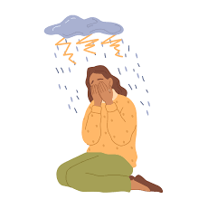
Emotional Symptoms of Rejection Sensitive Dysphoria
Intense feelings of sadness, shame, and embarrassment
Low self-esteem and feelings of inadequacy
Anxiety and worry about future rejection or criticism
Increased hopelessness
Increased Anger and irritability
Difficulty trusting others
Fear of abandonment
Difficulty forming and maintaining relationships
Difficulty participating in social situations
Difficulty with self-acceptance
Increased Suicidal ideation

Slide 19
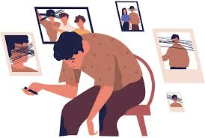
Physical Symptoms of Rejection Sensitive Dysphoria
Increased heart rate and blood pressure
Sweating and trembling
Stomach upset or nausea
Headaches or migraines
Fatigue and difficulty sleeping
Loss of appetite or difficulty eating
Difficulty with concentration and focus
Difficulty with physical coordination
Difficulty with self-care
Self-harm

Slide 20
What is Emotional dysregulation ?
Emotional dysregulation refers to difficulty controlling one's emotions, resulting in intense and/or prolonged emotional responses to triggers.
55% of children with ADHD met criteria for emotion dysregulation.
38% of children with ADHD experiences moderate to severe mood lability.

Slide 21
Emotional Symptoms of Emotional dysregulation
Irritability or anger outbursts
Rapid mood swings
Overreaction to small things
Difficulty calming down or regulating emotions
Difficulty expressing emotions in a healthy way
Chronic sadness or hopelessness
Self-harm or suicidal thoughts
Anxiety or panic attacks

Slide 22
Physical Symptoms of Emotional dysregulation
Tense muscles or muscle tension
Headaches
Stomachaches or digestive issues
Fatigue or difficulty sleeping
Rapid heart rate or palpitations
Sweating
Shaking or trembling
Breathing difficulties
Lowered immune function

Slide 23
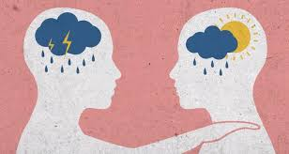
How is Rejection Sensitive Dysphoria and Emotional dysregulation Experienced?
No warning.
All at once. Instantaneous. 100%.
Surge of hurt and despair paired with physical discomfort.
Commonly physically painful as if hit in the chest.
Uncontrollable once it starts. Must run its course.
Feel a knot in the stomach or feel nauseous
Indescribable. No words to describe what it feels like.

Slide 24
Aspect | Rejection Sensitivity | Anxiety Disorders
Definition | A predisposition to anxiously expect, perceive, and react to rejection. | A group of mental health conditions characterized by excessive and persistent worry and fear.
Key Characteristics | Expectation of rejection Perception of rejection in ambiguous situations Intense emotional reactions to perceived rejection Behavioral responses aimed at avoiding rejection | Broad range of symptoms across various contexts Persistent and excessive worry Physical symptoms like heart palpitations and trembling Interference with daily life Avoidance of a wide range of anxiety-provoking situations
Trigger | Social interactions and the potential for rejection. | Various stimuli and situations, not limited to social contexts.
Emotional Response | Hurt, anger, or sadness specifically in response to perceived rejection. | Generalized worry, fear, and anxiety in various situations.
Behavioral Response | Withdrawal from social situations, aggression as self-defense. | Avoidance of situations or activities that provoke anxiety, which can be broader than social situations.

Slide 25
Aspect | Rejection Sensitivity | Mood Disorders
Definition | A predisposition to anxiously expect, perceive, and react to rejection. | A mood disorder characterized by persistent feelings of sadness, loss, or anger.
Key Characteristics | Expectation of rejection Perception of rejection in ambiguous situations Intense emotional reactions to perceived rejection Behavioral responses aimed at avoiding rejection | Persistent sadness or low mood Loss of interest in activities once enjoyed Changes in appetite and sleep patterns Feelings of worthlessness or guilt Difficulty concentrating Thoughts of death or suicide
Trigger | Social interactions and the potential for rejection. | Can be triggered by a variety of factors, including biological, psychological, and environmental stressors.
Emotional Response | Hurt, anger, or sadness specifically in response to perceived rejection. | A pervasive low mood that affects all aspects of an individual's life.
Behavioral Response | Withdrawal from social situations, aggression as self-defense. | Withdrawal from social and daily activities, reduced energy, and changes in activity levels.

Slide 26
How ADHD can Affect Emotions

Slide 27
How ADHD can Affect Emotions
Emotions: Positive and negative—play a critical role in:
Prioritizing and getting started on tasks.
Sustaining or shifting interest/effort
Holding thoughts in active memory
Choosing to engage in or avoid situations
Notes:
Prioritizing Emotions, negative emotions can be why individuals with ADHD, Anxiety, and Depression are so prone to procrastination
Difficulty with working memory can also be indicative of ADHD, but it is more indicative of Anxiety as anxiety “takes up space” in the mind and makes it difficult to hold information

Slide 28
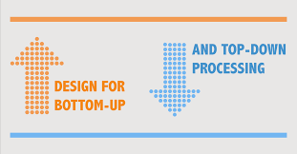
How ADHD can Affect Emotions
Bottom-Up Processes
Difficulty with rapidly and accurately recognizing emotions in human faces or voices.
Emotional misperception is linked with aberrant emotional responses.
Misperception is linked to increased emotional dysregulation.
Signal for potential reward (Aversion to delayed reward).
Notes:
Bottom-up processing slowly reading startbucks and coming up with all the information we know about starbucsk
It can also be difficulty with emotional recognition that means we fail to read cues that would help us from “blowing up”
The cookie form the Cookie jar

Slide 29
How ADHD can Affect Emotions
Top-Down Processes
Difficulty with allocation of attention to emotionally arousing stimuli.
Executive functions, such as attention and working memory, to control impulsivity and hyperactivity are impacted by ADHD.
Emotional management involves an individual using their cognitive abilities to regulate their emotions and respond appropriately to different situations.
Notes:
Top down is very fast. Caffeine addicts
It can also be children, or adults who were children, that have learned they are smart but lazy or that they always screw up
think heuristics
This can lead to cognitive distortions but also self fulfilling proficies

Slide 30
How ADHD can Affect Emotions
Reactions to small frustrations can gobble up all the space in their mind—like a computer virus
frustration/anger
Hurt feelings
Got to have it now”
While flooded with one emotion, persons with ADHD tend to forget about other relevant emotion.
Notes:
This, “gotta have it now” is important in that it can cause individuals to ignore future consequences as well as fail to prepare

Slide 31
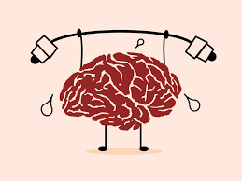
How ADHD can Affect Emotions
Low Working Memory
Impairment in working memory may impact an individual's ability to regulate their emotions.
The ability to hold and process information related to emotions is dependent on working memory capacity.
Deficit in working memory leads to insufficiency in attending to multiple emotions all at once leading to emotional flooding.
Notes:
I want to talk now about how they work together and how they cycle and how people try to coupe with different levels of succuss
The spinners in the Day treatment center
The master procrastinators

Slide 32
How an ADHD Brain Differs from A Non-ADHD Brain
Brain Structure
Brain Function
Brain Chemistry

Slide 33
Brain Structure
Smaller brain volume in five subcortical areas.
Smaller total brain size (by roughly 3%).
Amygdala and hippocampus are smaller in the brains of people with ADHD.
Smaller Prefrontal Lobe
Notes:
While it may seem that a smaller amygdala could be good, as a lot of negative emotions come from the amygdale, it can lead the amygdala to be over reactive without as much nuanced controls

Slide 34
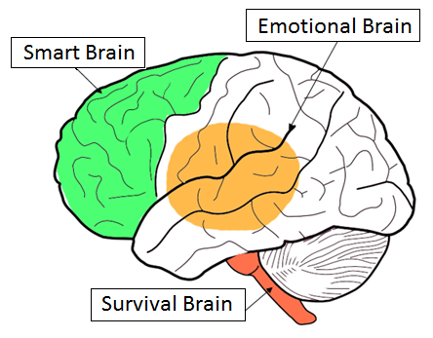
Emotional Brain vs. Cognitive Brain
Notes:
Smart brain tends to be less effective, the emotional brain tends to be overreactive
This means more activation of the emotional brain and less ability to put the breaks on with the smart brain

Slide 35
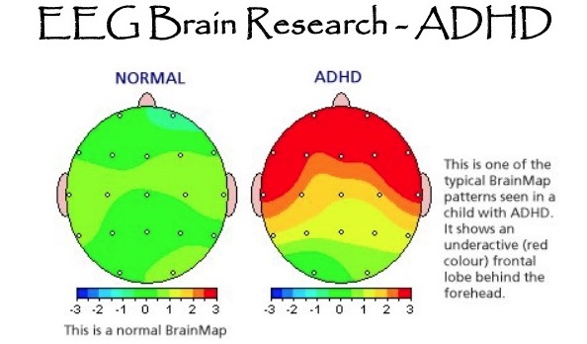
Brain Function
Decreased blood flow to certain prefrontal areas.
Decreased functional connectivity in parts of the bilateral cingulate and paracingulate cortex.
Increased functional connectivity in the left putamen, right caudate nucleus, right central operculum.

Slide 36
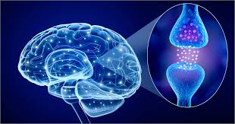
Brain Chemistry
Dysregulation of the dopamine system.
There is either too little dopamine, not enough receptors for it.

Slide 37
Psychopharmacological Strategies

Slide 38
Psychopharmacological Treatments for Emotional Dysregulation and Rejection sensitivity
Alpha-2 receptor agonists.
Stimulant medications.
Clonidine
Guanfacine
Amphetamine/dextroamphetamine (commonly known as Adderall)
Methylphenidate (better known as Ritalin)

Slide 39
Nutritional Strategies

Slide 40
Nutritional Strategies for Managing Emotional Dysregulation and Rejection sensitivity
Daily multivitamin
Consider taking a daily multivitamin supplement that contains .
Vitamin C
Vitamin E, B-12, selenium and folic acid.
Avoid over-load by following recommended daily allowance.
Notes:
We are not medical doctors. This is likely obvious when it comes to pills but with supplements and nutrition it is important to consult a medical doctor as too little or too much of a substance can be a problem
Sugar
Study out of Korea, more sugar consumption in groups with lower ADHD symptoms, huh?
both groups had the same amount of snack sugar but the lower symptom group had more fruit sugar
Could be related to our first item, vitamin C
Folic acid can be important especially if you don’t process folic acid well. If you don’t process folic acid well, SSRI’s can be less effective

Slide 41
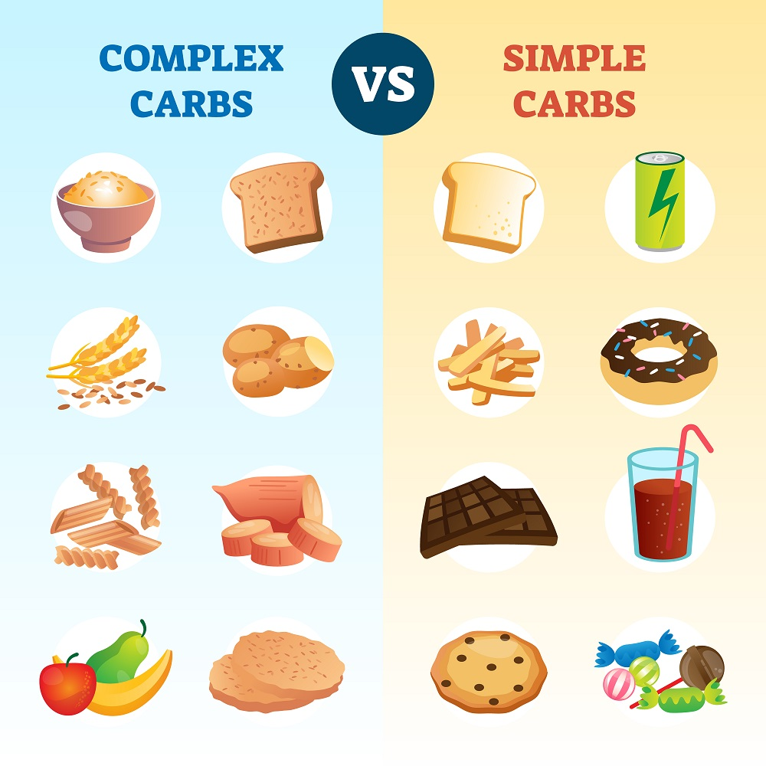
Nutritional Strategies for Managing Emotional Dysregulation and Rejection sensitivity
Watch out for simple carbs
Refined carbohydrates stimulate the release of dopamine, just as stimulant medications and adrenaline do.
This means that people with ADHD get in the habit of turning to carbs to get dopamine squirt.
Carbs cause insulin to be dumped into your system.
Notes:
What? I thought people with ADHD were low in dopamine?
getting your dopamine through food is a common trait in people with ADHD
Can have health consequences including and not limited to diabetes
Also, getting dopamine from carbs means you are not seeking dopamine through achievement

Slide 42
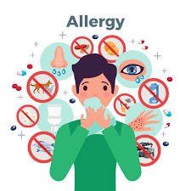
Nutritional Strategies for Managing Emotional Dysregulation and Rejection sensitivity
Watch out for other food allergies
Many people with ADHD have undiagnosed food allergies.
Food allergies can have an impact on certain neurotransmitters in the brain that are involved in regulating mood and emotion, which can lead to emotional dysregulation.
The symptoms of allergens can cause feelings of anxiety or fear.
Notes:
Also, food allergies can lead to being a “picky eater” which can lead to nutrition problems

Slide 43
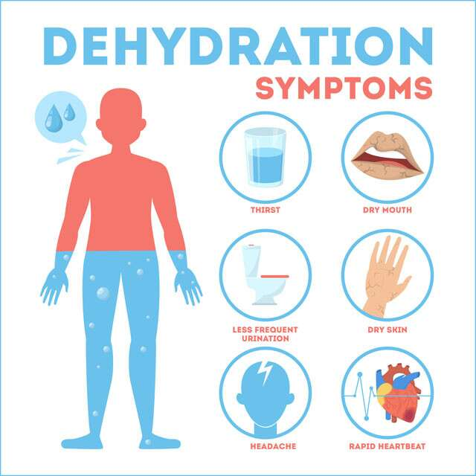
Nutritional Strategies for Managing Emotional Dysregulation and Rejection sensitivity
Increase Water Intake (Drive them to Drink)
It is estimated that 75 percent of us are chronically dehydrated
Dehydration can lead to decreased focus, increased irritability, fatigue, and difficulty concentrating.
Dehydration can also lead to changes in the levels of certain neurotransmitters, such as dopamine and serotonin, which are involved in regulating mood and emotion.
Notes:
Everyone is dehydrated

Slide 44
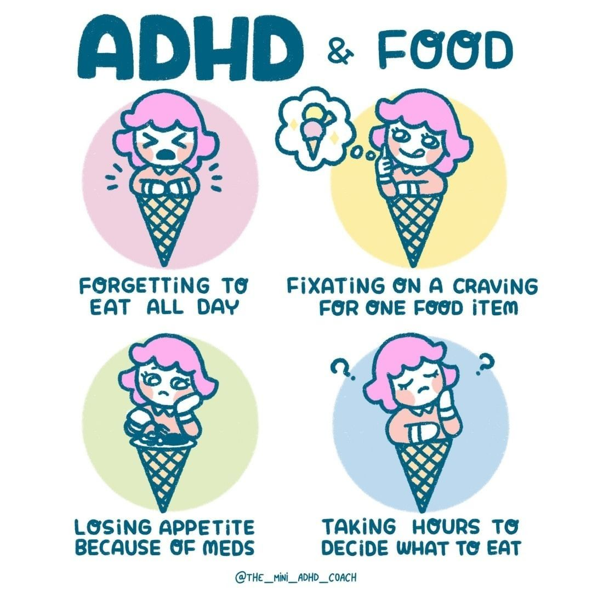
Nutritional Strategies for Managing Emotional Dysregulation and Rejection sensitivity
Monitor eating habits
People with ADHD are at greater risk for developing an eating problem than the general public.
Food as a source of stimulating conflict.
Inconsistent and unhealthy cycle of an eating can impact attentional and emotional regulation.
Notes:
Forgetting to eat reduces nutrition but it specifically means your frontal lobe does not have the energy it needs
meds can be a part of this problem or it can be independent
Once you do decide what you want, it is often fast and low nutrient density

Slide 45
Nutritional Strategies for Managing Emotional Dysregulation and Rejection sensitivity
Tap the Oil Daily (Omega-3s)
Low levels of omega-3s lead to chronic inflammation throughout the body
Individuals with ADD are especially low in omega-3s.
Aside from the general health benefits of omega-3, we know that omega-3s increase the levels of dopamine in the body, as do ADHD stimulants.
Watch out for oxidization and it impact on the brain.
Notes:
Oxidization can cause fish oil to not pass the blood brain barrier. That means it helps the body but not the brain
Single serving is important
Eating fish?

Slide 46
Nutritional Strategies for Managing Emotional Dysregulation and Rejection sensitivity
Include Zinc, Iron, and Magnesium
Zinc regulates the neurotransmitter dopamine.
Iron is necessary for making dopamine.
Like zinc, magnesium is used to make neurotransmitters involved in attention and concentration, and it has a calming effect on the brain.
While diet is the safest way to increase all three mineral levels, a multivitamin/multimineral with iron will ensure that you or your child gets the daily reference value (DRV) of these miner

Slide 47
Behavioral and Emotional Coping Strategies

Slide 48
The goals of Emotional and Behavioral coping
To reduce stressful environmental conditions and maximize the chance of recovery.
To adjust or tolerate negative events.
To maintain a positive self-image.
To maintain emotional equilibrium
To continue satisfying relationship with others.

Slide 49
Two Types of Coping Skills
Emotion-Focused Coping Skills
Problem-Focused Coping Skills
Help children and adolescents deal with feelings so they are less stressed
Teaches how to tolerate stress and gain perseverance
Necessary for situations that cannot be changed.
Involve taking action to change a situation
Empower children and adolescents to take control of a difficult situation
Necessary for situations where things can be changed.

Slide 50
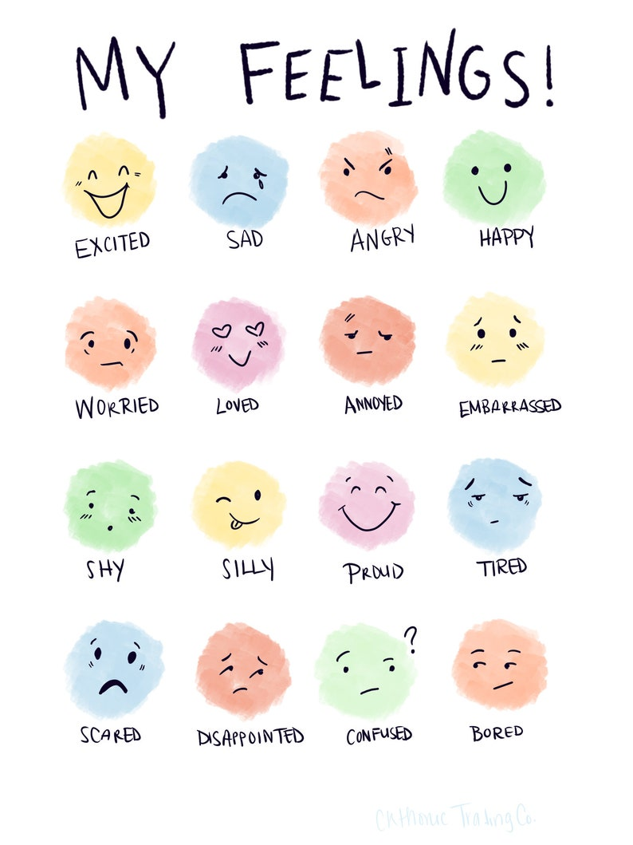
Emotion-Focused Coping Skills
Labeling Feelings
Put Emotions into Words.
Labeling emotions allows kids and adolescents to notice and put a name to emotions.
Naming or labelling emotions helps kids and adolescents untangle or unstick from them.

Slide 51
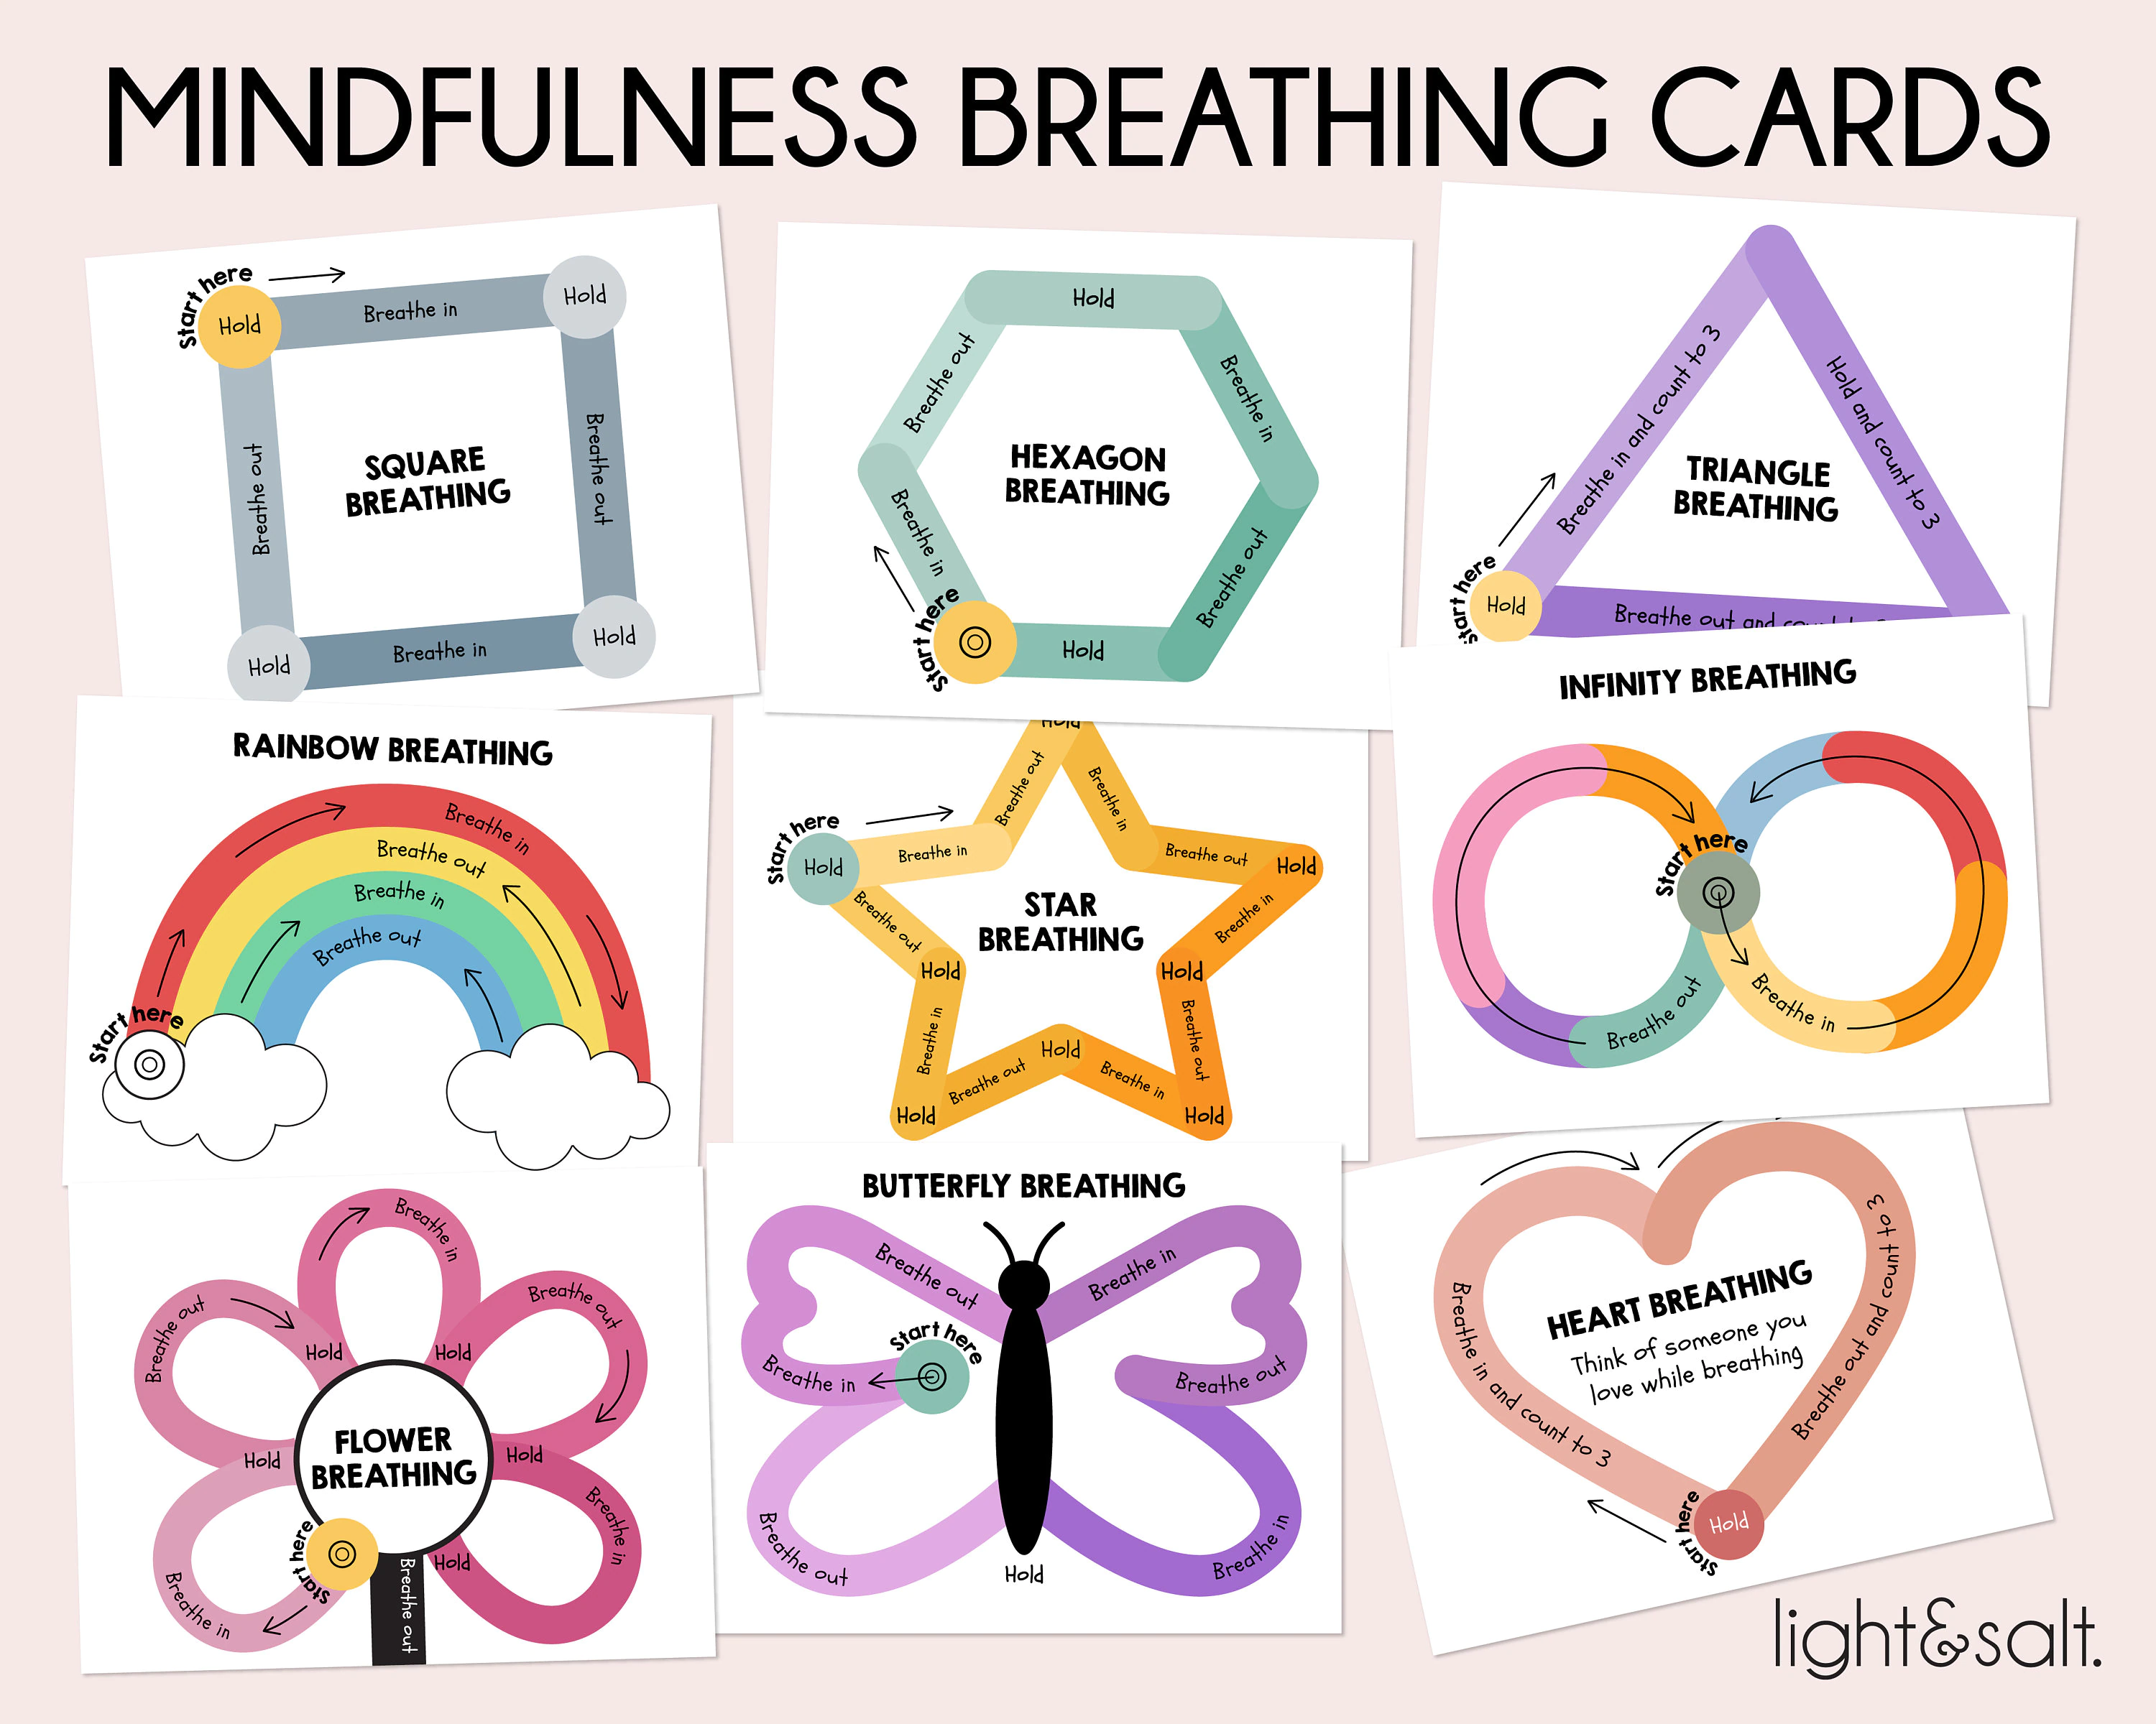
Emotion-Focused Coping Skills
Practice Breathing Exercises
Breathing exercises are a powerful way to teach emotional management.
Breathing experiences increases comfort, relaxation, pleasantness, vigor and alertness, and reduced symptoms of arousal, anxiety, depression, anger, and confusion.

Slide 52
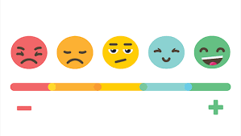
Emotion-Focused Coping Skills
Exercise and Physical Activity
Exercise helps get out excess energy when they’re nervous
Boost their mood when they’re down.
Strength building exercises like lifting weights and aerobic exercises like running or biking can be excellent ways to help children and adolescents regulate their emotions.

Slide 53
Emotion-Focused Coping Skills
Positive Self-Talk
With rejection sensitivity and emotions dysregulation self-talk is likely to become negative.
Positive self-talk begins with an awareness or recognition of negative thoughts and messages children, or adolescent are saying to themselves.
Having regular conversations about positive self-talk.
Normalize Recognizing Strengths

Slide 54
Problem-Focused Coping Skills
Journaling and Creative Expression
Journaling and expressive writing may help children and adolescents learn more about themselves and their emotions.
Other creative or expressive outlets may include:
Drawing
Painting
Listening to music
Playing an instrument

Slide 55
Problem-Focused Coping Skills
List the Pros and Cons
Teach children and adolescents to consider a situation from a different point of view.
Encourage making a list of pros and cons.
What else is there ?

Slide 56
Problem-Focused Coping Skills
Asking for support
Brainstorm Conversation Starters
“I’m having trouble with ____. Can you explain it to me later?”
“Can you give me advice about ____?”
“I don’t understand _____. Can you help me?”

Slide 57
Proactive Action plan
Proactive action plan, just like a safety plan, is a guide to help caregivers recognize the signs and symptoms of stress/burnout and be prepared with an action plan that can be implemented.
List the symptoms of stress (Emotional, Physical, Cognitive and Behavioral Symptoms).
List situational and cognitive triggers (e.g., unfamiliar situations, negative thoughts, etc.)
The most helpful grounding technique(s):
The most helpful relaxation exercise(s):
When I feel stressed or overwhelmed, it is helpful for me to:
When I feel stressed or overwhelmed, it is unhelpful for me to:
Who to call (Include mental health providers if involved and appropriate. Include several supportive adults or friend).

Slide 58
Practice RUNS
Parents get discouraged when things do not go well the first time they try skill-building.
Dry/Practice Runs are another way to scaffold self-regulation.
Focuses on Practicing before expecting an Outcome.
Children and Adolescents learn best when they practice before they are expected to Perform a given tasks or behavior.

Slide 59
Thanks
gary@calm.us
benjamin@calm.us
kotatee@calm.us
kelsey@calm.us
CALM
612-872-2343
www.calm.us

Slide 60
Coping Strategies Resources
Labeling Feelings
How to Help a Highly Emotional Child Cope With Big Feelings: https://www.verywellfamily.com/how-to-help-an-overly-emotional-child-4157594
Helping a Child Deal With Uncomfortable Emotions: https://www.verywellfamily.com/teach-your-child-to-deal-with-uncomfortable-emotions-1095028
Exercise and Physical Activity
How and why to get children moving now: https://www.apa.org/topics/covid-19/children-exercise-strategies.
Making Physical Activity a Part of a Child’s Life: https://www.cdc.gov/physicalactivity/basics/adding-pa/activities-children.html
Chapter 3. Active Children and Adolescents: https://health.gov/sites/default/files/2019-09/Physical_Activity_Guidelines_2nd_edition.pdf#page=53

Slide 61
Coping Strategies Resources
Breathing Exercises
Breathing Exercises for Kids: https://copingskillsforkids.com/deep-breathing-exercises-for-kids
7 Fun Breathing Exercises for Kids That Actually WORK!: https://www.yoremikids.com/news/best-breathing-exercises-for-kids
Five Fun Breathing Exercises For Kids: https://cosmickids.com/five-fun-breathing-exercises-for-kids/
Positive Self Talk:
How to Teach Kids to Engage in Positive Self-Talk: https://www.verywellfamily.com/how-to-teach-kids-to-engage-in-positive-self-talk-5205084
How to Teach Positive Self-Talk : https://www.thepathway2success.com/how-to-teach-positive-self-talk/
Teaching children to use positive self-talk to build self-confidence: https://kidsintransitiontoschool.org/teaching-children-to-use-positive-self-talk-to-build-self-confidence/

Slide 62
Coping Strategies Resources
"Calm Down" Kit
How to Make A Calm Down Box in 5 Minutes (for Kids and Adults): https://www.childsavers.org/calm-down-box/
Supporting Children to Regulate Their Emotions with a Calm Down Kit: https://hdfs.hs.iastate.edu/wp-content/uploads/sites/7/2020/10/Calm-Down-Kit_Luze_9-13-19.pdf
How to Create a Calm Down Corner in 5 Easy Steps: https://theartofeducation.edu/2019/01/21/how-to-create-a-calm-down-corner-in-5-easy-steps/
Teaching Perspective Taking
How to Teach Perspective-Taking to Children: https://www.speechandlanguagekids.com/how-to-teach-perspective-talking-to-children/
Helping Kids Make Decisions: https://childmind.org/article/helping-kids-make-decisions/

Slide 63
Coping Strategies Resources
Journaling and creative expression: https://pongopoetryproject.org/write-with-us/writing-activities/
Asking for Help
9 Strategies To Help Teens Learn How To Ask For Help: https://lifeskillsadvocate.com/blog/how-to-teach-teens-to-ask-for-help/
Asking for Help: Getting Past Obstacles: https://kidshealth.org/en/teens/help-obstacles.html
Teaching Kids How To Ask For Help: https://betterkids.education/blog/teaching-kids-how-to-ask-for-help
How to Handle Tantrums and Meltdowns: https://childmind.org/article/how-to-handle-tantrums-and-meltdowns/
How to Help Children Calm Down: https://childmind.org/article/how-to-help-children-calm-down/#coping-ahead

Slide 64
Behavioral and Emotional Coping Strategies References and Additional Reading
Halliwell, E., Jarman, H., Tylka, T.L., & Slater A. (2018). Evaluating the impact of a brief yoga intervention on preadolescents' body image and mood. Body Image, 27:196-201. doi:10.1016/j.bodyim.2018.10.003
Kopp, C.B.(2009). Emotion-focused coping in young children: Self and self-regulatory processes. New Dir Child Adolesc Dev, 124 , 33-46. doi:10.1002/cd.241
Lee-Winn AE, Mendelson T, Johnson RM. Associations between coping and marijuana use in a nationally representative sample of adolescents in the United States. Addict Behav. 2018;80:130-134. doi:10.1016/j.addbeh.2018.01.02
Lieberman, M. D., Eisenberger, N. I., Crockett, M. J., Tom, S. M., Pfeifer, J. H., & Way, B. M. (2007). Putting feelings into words: affect labeling disrupts amygdala activity in response to affective stimuli. Psychological science, 18(5), 421–428. https://doi.org/10.1111/j.1467-9280.2007.01916.x
Ones DE, Greenberg M, Crowley M.(2015). Early social-emotional functioning and public health: The relationship between kindergarten social competence and future wellness. Am J Public Health, 105(11):2283-90. doi:10.2105/ajph.2015.302630
Perciavalle V, et al. (2017). The role of deep breathing on stress. link.springer.com/article/10.1007/s10072-016-2790-8
Sohal M, et al. (2022). Efficacy of journaling in the management of mental illness: A systematic review and meta-analysis. fmch.bmj.com/content/10/1/e001154
Zaccaro A, et al. (2018). How breath-control can change your life: A systematic review on psycho-physiological correlates of slow breathing. frontiersin.org/articles/10.3389/fnhum.2018.00353/full

Slide 65
ADHD and Irritability References and Additional Reading
American Psychiatric Association. (2013). Diagnostic and statistical manual of mental disorders (5th ed.). Washington, DC: Author.
Barkley RA. Emotional dysregulation is a core component of ADHD. In: Barkley, RA, ed., Attention-deficit Hyperactivity Disorder: A Handbook for Diagnosis and Treatment. The Guilford Press; 2015:81-115.
Beaton, D., Sirois, F. M., & Milne, E. (2022). Experiences of criticism in adults with ADHD: A qualitative study. In PLOS ONE (Vol. 17, Issue 2, p. e0263366). Public Library of Science. https://doi.org/10.1371/journal.pone.0263366
Del Campo N, Chamberlain SR, Sahakian BJ, Robbins TW. The Roles of Dopamine and Noradrenaline in the Pathophysiology and Treatment of Attention-Deficit/Hyperactivity Disorder. Biol Psychiatry. 2011;69(12):e145-157. doi:10.1016/j.biopsych.2011.02.036
Karalunas, S. L., Gustafsson, H. C., Fair, D. A., Musser, E. D., & Nigg, J. T. (2019). Do we need an irritable subtype of ADHD? Replication and extension of a promising temperament profile approach to ADHD subtyping. Psychological Assessment, 31(2), 236–247. https://doi.org/10.1037/pas0000664
Lange, K. W., Reichl, S., Lange, K. M., Tucha, L., & Tucha, O. (2010). The history of attention deficit hyperactivity disorder. Attention deficit and hyperactivity disorders, 2(4), 241–255. https://doi.org/10.1007/s12402-010-0045-8
Shaw, P., Stringaris, A., Nigg, J. T., & Leibenluft, E. (2014). Emotion Dysregulation in Attention Deficit Hyperactivity Disorder. American Journal of Psychiatry, 171(3), 276–293. https://doi.org/10.1176/appi.ajp.2013.13070966
Singh, I. (2011). A disorder of anger and aggression: Children’s perspectives on attention deficit/hyperactivity disorder in the UK. Social Science & Medicine, 73(6), 889–896. https://doi.org/10.1016/j.socscimed.2011.03.049

Slide 66
Rejection Sensitivity and emotional dysregulation References
Dodson, W, (2022). New Insights Into Rejection Sensitive Dysphoria. ADDitude. https://www.additudemag.com/rejection-sensitive-dysphoria-adhd-emotional-dysregulation/
Faraone, S. V., Rostain, A. L., Blader, J. C., Busch, B., Childress, A. C., Connor, D. F., & Newcorn, J. H. (2019). Practitioner Review: Emotional dysregulation in attention-deficit/hyperactivity disorder - implications for clinical recognition and intervention. Journal of Child Psychology and Psychiatry, 60(2), 133–150. https://doi.org/10.1111/jcpp.12899
Gao, S., Assink, M., Liu, T., Brownridge, D. A., & Ip, P. (2021). Associations Between Rejection Sensitivity, Aggression, and Victimization: A Meta-Analytic Review. Trauma, Violence, & Abuse, 22(1), 125–135. https://doi.org/10.1177/1524838019833005
Hance, M. A., Blackhart, G. C., & Dew, M. (2018). Free to be me: The relationship between the true self, rejection sensitivity, and use of online dating sites. Journal of Social Psychology, 158(4), 421–429. https://doi.org/10.1080/00224545.2017.1389684
Hsu, D., & Jarcho, J. M. (2021). “Next up for psychiatry: rejection sensitivity and the social brain.” Neuropsychopharmacology, 46(1), 239–240. https://doi.org/10.1038/s41386-020-00802-9
Jittayuthd, S., & Karl, A. (2022). Rejection sensitivity and vulnerable attachment: associations with social support and PTSD symptoms in trauma survivors. European Journal of Psychotraumatology, 13(1). https://doi.org/10.1080/20008198.2022.2027676
Karalunas, S. L., Gustafsson, H. C., Fair, D. A., Musser, E. D., & Nigg, J. T. (2019). Do we need an irritable subtype of ADHD? Replication and extension of a promising temperament profile approach to ADHD subtyping. Psychological Assessment, 31(2), 236–247. https://doi.org/10.1037/pas0000664
Leng, Y., Qian, X., & Zhu, Y. (2018). Modulation of brain response to peer rejection by rejection sensitivity: An exploratory study. Neuropsychologia. https://doi.org/10.1016/j.neuropsychologia.2018.07.003
McPartland, J. C., Crowley, M. J., Perszyk, D. R., Naples, A. J., Mukerji, C. E., Wu, J., Molfese, P. J., Bolling, D. Z., Pelphrey, K. A., & Mayes, L. C. (2011). Temporal dynamics reveal atypical brain response to social exclusion in autism. Developmental Cognitive Neuroscience, 1(3), 271–279. https://doi.org/10.1016/j.dcn.2011.02.003
Nigg, J. T., Karalunas, S. L., Gustafsson, H. C., Bhatt, P., Ryabinin, P., Mooney, M., Faraone, S. V., Fair, D. A., & Wilmot, B. (2020). Evaluating chronic emotional dysregulation and irritability in relation to ADHD and depression genetic risk in children with ADHD. Journal of Child Psychology and Psychiatry, 61(2), 205–214. https://doi.org/10.1111/jcpp.13132
Soler-Gutiérrez, M., Pérez-González, C., & Mayas, J. (2023). Evidence of emotion dysregulation as a core symptom of adult ADHD: A systematic review. PLOS ONE, 18(1), e0280131. https://doi.org/10.1371/journal.pone.0280131
Stringaris, A., Vidal-Ribas, P., Brotman, M. A., & Leibenluft, E. (2018). Practitioner Review: Definition, recognition, and treatment challenges of irritability in young people. Journal of Child Psychology and Psychiatry, 59(7), 721–739. https://doi.org/10.1111/jcpp.12823

Slide 67
Nutritional Recommendations References and Additional Reading
Cooper, R. E., Tye, C., Kuntsi, J., Vassos, E., & Asherson, P. (2016). The effect of omega-3 polyunsaturated fatty acid supplementation on emotional dysregulation, oppositional behaviour and conduct problems in ADHD: A systematic review and meta-analysis. Journal of Affective Disorders, 190, 474–482. https://doi.org/10.1016/j.jad.2015.09.053
Johnson, M., S. Ostlund, G. Fransson, B. Kadesjo, and C. Gillberg. “Omega-3/Omega-6 Fatty Acids for Attention Deficit Hyperactivity Disorder: A Randomized Placebo-Controlled Trial in Children and Adolescents.” Journal of Attention Disorders, vol. 12, no. 5, 2009, pp. 394-401.
Jones, T W, et al. “Enhanced Adrenomedullary Response and Increased Susceptibility to Neuroglycopenia: Mechanisms Underlying the Adverse Effects of Sugar Ingestion in Healthy Children.” The Journal of Pediatrics, vol. 126, no. 2, 1995, pp. 171–177.
McCann, D. C., Barrett, A., Cooper, A., Crumpler, D., Dalen, L., Grimshaw, K., Kitchin, E. M., Lok, K. Y. W., Porteous, L., Prince, E. B., Sonuga-Barke, E. J., Warner, J. O., & Stevenson, J. (2007a). Food additives and hyperactive behaviour in 3-year-old and 8/9-year-old children in the community: a randomised, double-blinded, placebo-controlled trial. The Lancet, 370(9598), 1560–1567. https://doi.org/10.1016/s0140-6736(07)61306-3
McCann, D. C., Barrett, A., Cooper, A., Crumpler, D., Dalen, L., Grimshaw, K., Kitchin, E. M., Lok, K. Y. W., Porteous, L., Prince, E. B., Sonuga-Barke, E. J., Warner, J. O., & Stevenson, J. (2007b). Food additives and hyperactive behaviour in 3-year-old and 8/9-year-old children in the community: a randomised, double-blinded, placebo-controlled trial. The Lancet, 370(9598), 1560–1567. https://doi.org/10.1016/s0140-6736(07)61306-3
Prinz, R. et al. “Dietary Correlates of Hyperactive Behavior in Children.” Journal of Consulting and Clinical Psychology, vol. 48, no. 6, 1980, pp. 760–769.
Reading, R. (2005). Iron deficiency in children with attention-deficit/hyperactivity disorder. Child Care Health and Development. https://doi.org/10.1111/j.1365-2214.2005.00504_7.x
Rucklidge, J. J., Frampton, C., Gorman, B., & Boggis, A. (2014). Vitamin–mineral treatment of attention-deficit hyperactivity disorder in adults: double-blind randomised placebo-controlled trial. British Journal of Psychiatry, 204(4), 306–315. https://doi.org/10.1192/bjp.bp.113.132126
Young, G. S., & Conquer, J. A. (2005). Omega-3 fatty acids and neuropsychiatric disorders. Reproduction Nutrition Development, 45(1), 1–28. https://doi.org/10.1051/rnd:2005001

Slide 68
Pharmacotherapy Treatment References and Additional Reading
Budur, K., Mathews, M., Adetunji, B., Mathews, M., & Mahmud, J. (2005). Non-stimulant treatment for attention deficit hyperactivity disorder. Psychiatry (Edgmont (Pa. : Township)), 2(7), 44–48.
Childress, A. C., & Sallee, F. R. (2015). Emotional Lability in Patients with Attention-Deficit/Hyperactivity Disorder: Impact of Pharmacotherapy. CNS Drugs, 29(8), 683–693. https://doi.org/10.1007/s40263-015-0264-9
Towbin, K., Vidal-Ribas, P., et. al. (2020). A Double-Blind Randomized Placebo-Controlled Trial of Citalopram Adjunctive to Stimulant Medication in Youth With Chronic Severe Irritability. Journal of the American Academy of Child & Adolescent Psychiatry, 59(3). https://doi.org/10.1016/j.jaac.2019.05.015
Lenzi, F., Cortese, S. et. al. (2018). Pharmacotherapy of emotional dysregulation in adults with ADHD: A systematic review and meta-analysis. Neuroscience and Biobehavioral Reviews, 84, 359-367. https://doi.org/10.1016/j.neubiorev.2017.08.010

